Slide 1


Slide 2


Slide 4
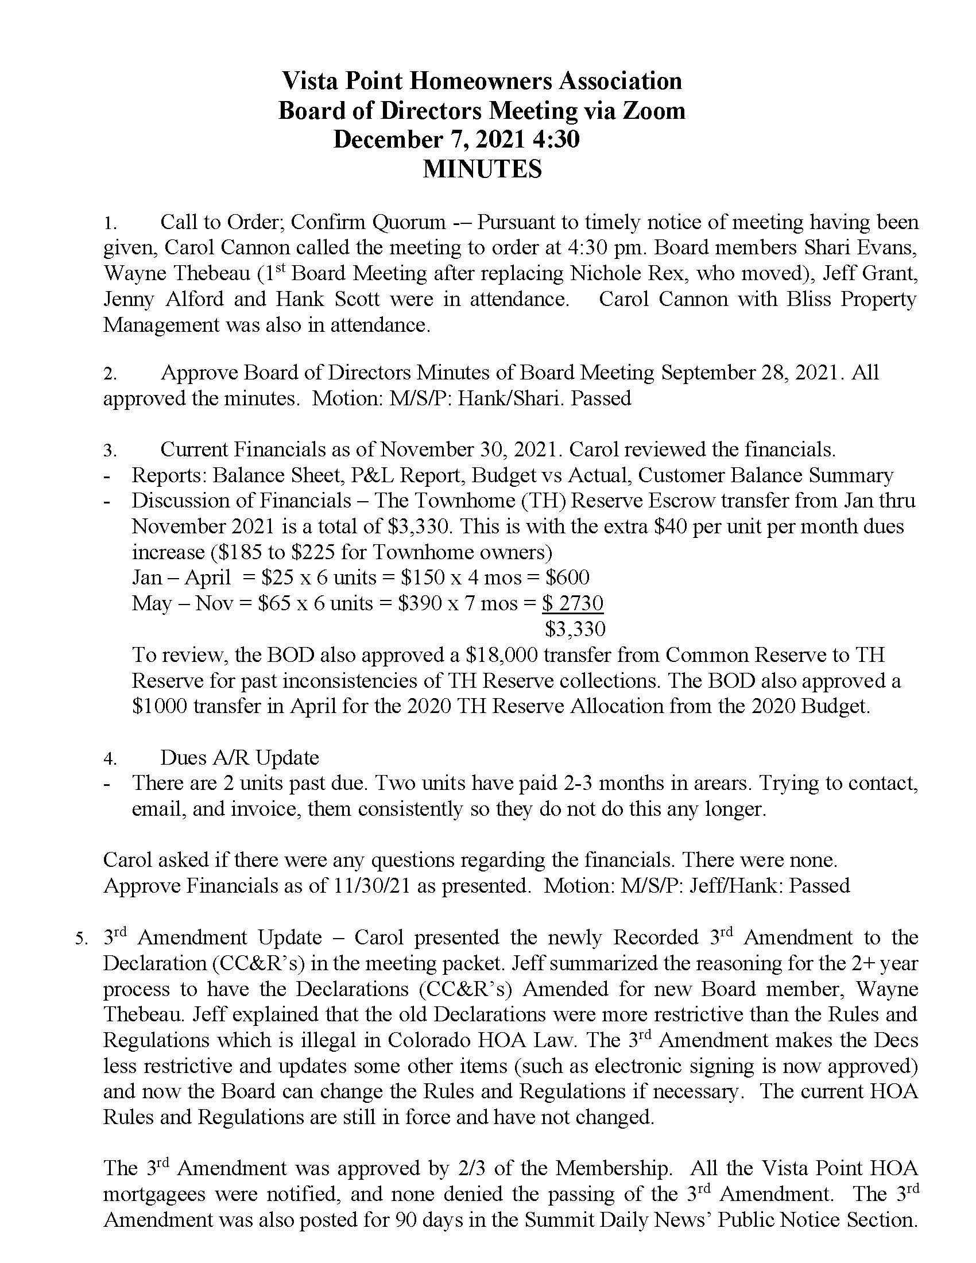

Slide 5
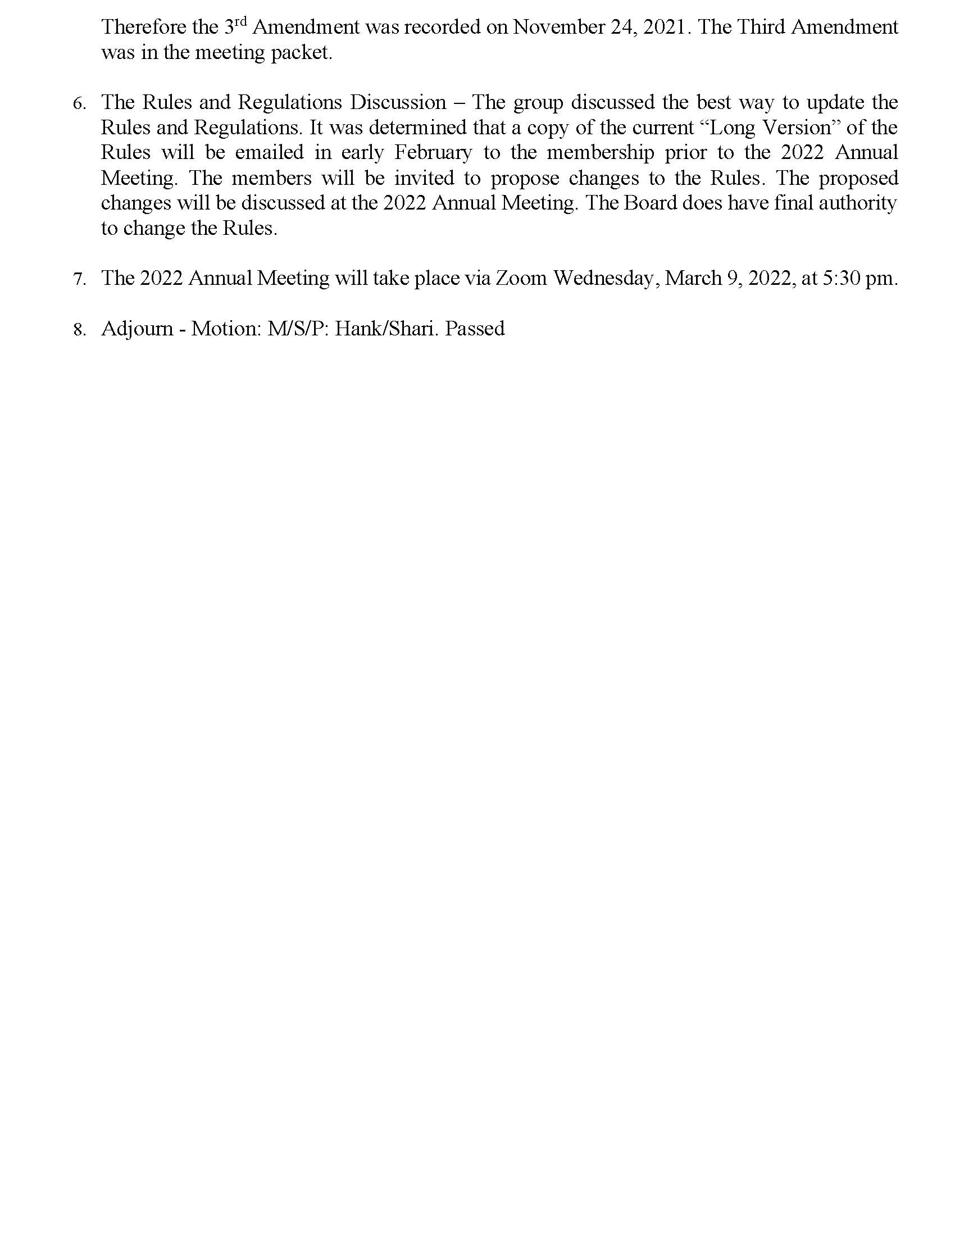

Slide 6
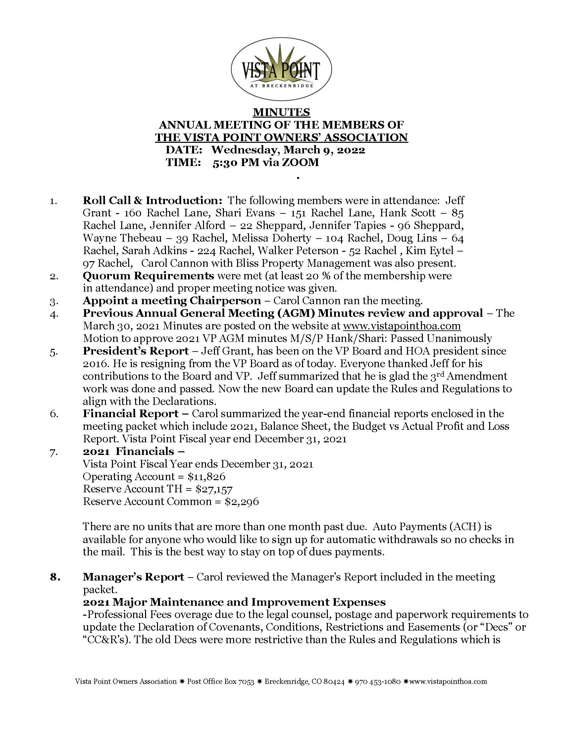

Slide 7
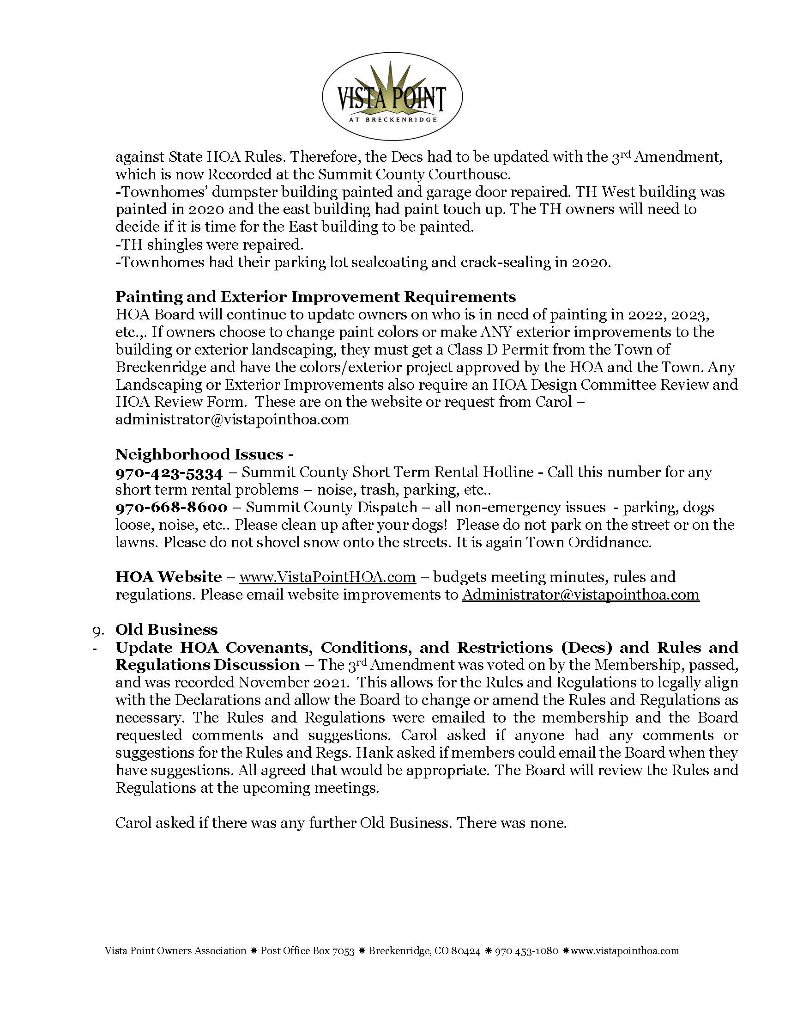

Slide 8
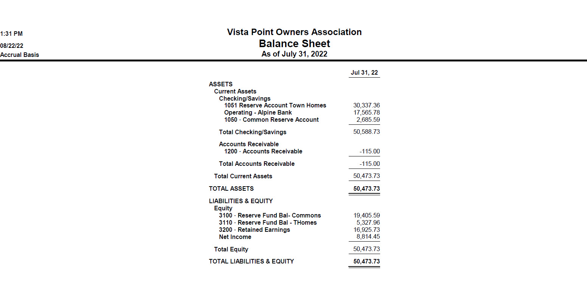

Slide 9
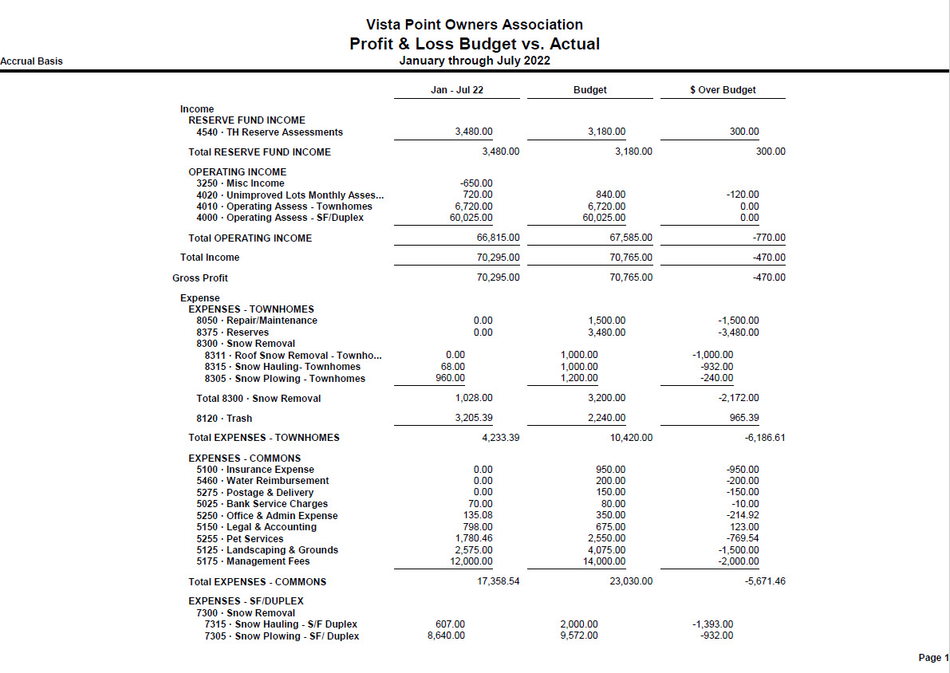

Slide 10
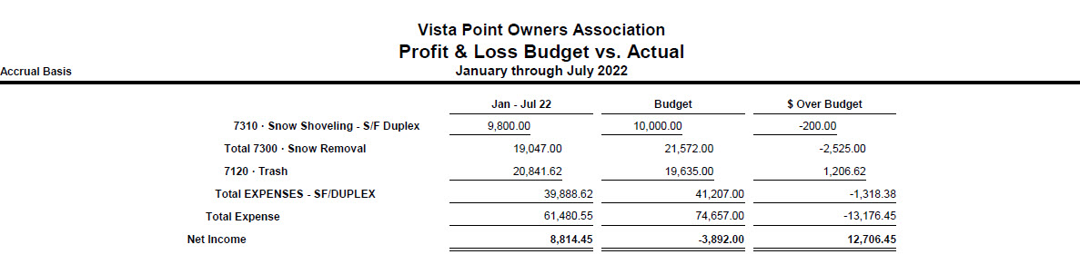

Slide 11
VISTA POINT OWNERS ASSOCIATION
Rules and Regulations
Authority: Pursuant to the authority granted by the Colorado Common Interest Ownership Act, the Bylaws of Vista Point Owners Association, and by Article V (Section 5.2) of the Declaration of Covenants, Conditions, Restrictions and Easements for Vista Point (the “Declaration”), together with any amendments, which are in full force and effect as of _____________, 2019, the Board of Directors of Vista Point Association hereby enacts the following rules and regulations. These rules and regulations shall replace all existing rules and regulations, as of __________________, 2019. If any provision herein conflicts with current applicable Colorado State Laws, or the contents of the Declaration, the State Laws and/or Declaration shall take precedence.
Purpose: It benefits all owners in the Vista Point community to establish, and abide by, Rules and Regulations to promote the common good, provide for uninhibited enjoyment, and to ensure a healthy and peaceful community, thus retaining a pleasant and attractive living environment.
ALL OWNERS AND NON-OWNER OCCUPANTS, GUESTS, RENTERS AND EMPLOYEES SHALL COMPLY WITH THESE RULES AND REGULATIONS, AS WELL AS THE COVENANTS AND RESTRICTIONS OF THE DECLARATION.
Responsibility – The Owner of any property is responsible for the conduct of tenants and guests. Owners will ensure that tenants and guests are aware of and comply with these Rules and Regulations, or any covenants and restrictions of the Declaration. Owners will be responsible for payment of any fines or other charges relating to their tenant and/or guest’s failure to comply with the Rules and Regulations or covenants and restrictions of the Declaration.
Home Improvements - No owner shall construct any structure or improvement, or make any structural or design change, either temporary or permanent, to the Lot or exterior of a home (Unit) without first obtaining written consent from the Architectural Review Committee, or the Board of Directors. Fences are permitted provided they comply with Town of Breckenridge permit specifications and the recorded master plan for Vista Point. All fences must be sealed in a natural finish and also require Board of Directors approval. Interior repairs or alterations of the home are permitted without such approval, provided they meet all codes and regulations of Town of Breckenridge. No used or second-hand structure, no building of a temporary character, tent or shack shall be placed or used on the Lot or the Community; except those necessary for approved construction. No television, radio or other antennas, including satellite dishes greater than 24 inches in diameter, shall be affixed to the exterior of the home. Any requested improvements must meet all Town of Breckenridge regulations and be submitted to the Board of Directors for approval in sketch and descriptive form.

Slide 12
Landscaping – No owner shall conduct any gardening or planting (with a full growth height of more than four feet), construct fencing, hedges or walls, or make any alteration to the landscaping without first obtaining written consent from the Architectural Review Committee (or the Board of Directors) and, in some cases, the Town of Breckenridge. Any requested improvements must meet all Town of Breckenridge regulations and be submitted to the Board of Directors for approval in sketch and descriptive form. Notwithstanding, and in accordance with Colorado State Laws [C.R.S. §37-60-126], an Owner shall be permitted to install drought-tolerant vegetative landscapes, or conduct other such xeriscpaing practices, without obtaining prior approval from the Architectural Review Committee or the Board of Directors.
Maintenance – Each owner shall be solely responsible for all maintenance and repair of his/her Lot, and of the interior of the home, or other improvements on the Lot (including all fixtures, utilities and equipment located on the Lot, and/or provided solely for the use of that owner). An exception exists for owners of the townhouse lots whereby the Association will maintain a Reserve of funds for the cost of exterior maintenance and repairs. No owner shall unreasonably damage the value of other Lots by the shoddy upkeep of his/her Lot. No cut grass, tree clippings or plant waste, lumber, metal, other building materials, scrap, refuse or trash shall be stored or allowed to accumulate in or on any Lot. Each owner shall maintain his/her Lot in a clean, safe, attractive, and sightly condition and in good repair. All personal property on any Lot shall be kept and maintained in a neat and orderly fashion. No clotheslines shall be permitted on any Lot.
Storage - Owners must keep any appurtenant porch, patio, deck, stairs, walkway and driveway in a safe, clean, orderly and sanitary condition. All patio, deck and lawn furniture, grills, bicycles, tricycles, toys and recreational equipment shall be kept in the backyard. Notwithstanding, customary lawn furniture is permitted to be stored in front yards during summer months.
Residential Use Only – No Unit or Lot, nor building placed upon the Lot, shall be used other than for a single family dwelling. No accessory apartment may be created in any Unit or on any Lot, without Town of Breckenridge approval. No Lot shall be occupied by more than two people per bedroom.
Signage - No signs, billboards, poster boards, or advertising structure of any kind (with exclusion of the project name and management company name), shall be erected or maintained for any purpose whatsoever outside of a home. Any real estate signs, including “For Sale”, “For Rent”, or similar shall require the written approval of the Board of Directors. In no event shall any signs advertising a home business or occupation be allowed. However, an Owner shall be permitted to display one American flag, and/or one military service flag, on that Owner’s property, in a window of the Owner’s residence, or on a balcony adjoining the Owner’s residence, if the flag is displayed in a manner consistent with the federal flag code, P.L. 94-344; 90 stat. 810; 4 U.S.C. 4 to 10. The military service flag may only be displayed if the resident, or the resident’s family member, is an active member of the United States military service during a time of war or armed conflict. The size of the American flag shall not exceed _________ square feet; the military service flag shall not exceed 9 inches by 16

Slide 13
inches. Flag poles shall not exceed _______ feet in height. Additionally, one political sign per political office or ballot issue that is contested in a pending election, may be displayed no earlier than 45 days before the day of election and no later than 7 days after the election day. Such political sign shall be no larger than 36 inches by 48 inches and shall be limited to display in a window of the resident’s Home, on the adjoining balcony, or in the front yard of the Home.
Trash – No trash, ashes, other refuse or debris may be thrown or dumped on the Property. The burning of any refuse or debris outdoors is prohibited. No outdoor storage of any trash, other than in community receptacles, or the resident’s enclosed trash receptacle(s), which must be kept inside the garage, protected from wildlife intrusion, until the day of collection by a commercial trash disposal company. Any trash displaced and dispersed upon the Lot or Community by wildlife, pets, wind, or alike, must be promptly picked up by the owner. Emptied containers must be promptly stored in the garage.
Pets – Owners may keep up to a total of 3 domestic pets on a Lot, but no more than 2 dogs or 2 cats, except with written permission of the Board of Directors. Pets must be kept on a leash at all times unless within a private fenced area. Owners of pets are responsible for immediate pick-up, and proper disposal, of waste from their pet. It is prohibited to allow continued barking or other noises from animals, either inside or outside of a home. In addition to such fines as imposed herein, an owner of a pet causing or creating a nuisance, or unreasonable disturbance or noise, shall be given Notice of Hearing from the Board of Directors, which may result in the offending pet(s) being permanently removed from the Property upon 3 days written notice following the Hearing. Other restrictions may apply as to the type and nature of pets permitted.
Noxious or Offensive Activity – No noxious or offensive activity shall be conducted, nor shall anything be done or placed upon a Lot, or the Community, that is or may become a nuisance or cause embarrassment, disturbance, or annoyance to others. Lights emitted from a Lot shall not be unreasonably bright nor cause unreasonable glare. No sound shall be unreasonably loud or annoying.
Vehicles and Parking – Licensed and operable passenger automobiles and pickup trucks shall be parked ONLY in the home’s garage, driveway or an approved gravel area. If a Homeowner wishes to expand a driveway or add a gravel parking area to their property, the Homeowner must first obtain approval from both the Town of Breckenridge and the Board of Directors. No graveling will be allowed in the Front Yard. Licensed trailers, motor homes, Recreational Vehicles, snowmobiles, or boats may be parked or stored in driveways or inside closed garages, subject to the following limitations. It is permissible to park Recreational Vehicles, trailers, and trailers holding snowmobiles or boats, in driveways for up to 72 hours at a time; provided, however this allowance is limited to two 72-hour periods in a 14 day period. This rule is not intended to enable neighbors to store trailers or other recreation vehicles outside permanently, rather it is intended to enable people to enjoy their toys and have them conveniently accessible during weekends or visits. No unlicensed or inoperable vehicles of any kind shall be parked or stored within the Community, except

Slide 14
inside a garage or approved structure. All garage doors must be kept closed when not in use for ingress and egress. No snowmobiles or other Off-Highway Vehicle shall be operated within the Community.” The common parking area, identified for town home residents and their guests, shall not be used by other owners, tenants or guests of the Community. Notwithstanding the foregoing, if a resident is a bona fide member of a volunteer fire department or is employed by a primary provider of emergency fire fighting, law enforcement, ambulance, or emergency medical services, the resident is permitted to park his/her work vehicle on the street adjacent the Home, in the driveway of the Home, or in the guest parking area. Permitted vehicles as such must be required to be available at designated periods, cannot be larger than ten thousand pounds gross vehicle weight, must bear an official emblem or other visible designation of the emergency service provider, and the parking of the vehicle must be accomplished without obstructing emergency access or interfering with the reasonable needs of other Lot Owners to use the streets, driveways and other parking areas within the common interest community. In addition to the fines imposed herein, vehicles in violation shall be given 48 hours’ notice of the Association’s right to tow. All expenses incurred from towing shall be charged to the offending vehicle owner, or to the owner of the Lot to which the vehicle owner resides or has visited. The Board of Directors reserves the right to make that determination.
Deed Restricted Lots – Some Lots are deed restricted and are subject to certain limitations on rental, occupancy, and resale price. The Deed Restricted Covenants are detailed in Article XVI of the Declaration. In addition, the Lot must be occupied by the owner as his/her primary residence. No business activity shall be conducted, unless in accordance with governmental ordinances or zoning district. Short-term rentals (less than 12 months) are not permitted. Only one twelve-month rental period is permitted during that owner’s ownership. However, rooms maybe rented to others provided the owner is concurrently in residence. No Lot shall be occupied by more than 2 unrelated people per bedroom. Owners shall abide by the resale conditions in accordance with the Deed Restrictions, including notifying the Town of Breckenridge of the desire to resell, prior to offering for sale.
Access - Common walkways, driveways, parking areas, entrances and passageways shall not be obstructed or used for any purpose other than ingress and egress. Personal property or pets shall not be left on the Common Area. Reasonable access to a home or Lot must be provided to the Association, its managing agent, employees or contractors, for necessary Association maintenance and repair services. Reasonable notice will be given except in cases of emergency. Failure to do so may result in damages and/or fines being assessed against the owner of the home to which access is required, and subsequently impeded or denied.
Assessments - Periodic Assessments (“monthly Dues”) are required by the first day of every month, with a fifteen (15) day “grace period” allowed before a $10 late charge is applied, per month late. Any delinquencies remaining by the end of the month (that is those that become at least 30 days delinquent) shall also incur interest at the rate of 15% per annum. Serious delinquencies, those 90 days delinquent or more, may also invoke other

Slide 15
remedies as the Board of Directors may enforce, as permitted by the Governing Documents, including, but not limited to, the filing of a lien against the Lot and possible legal action. All costs of collection shall be added to the owner’s account. Special Assessments shall be subject to the same grace period (following the due date), late fees and interest charges. All payments are deemed paid when a check or cash has been received by the Managing Agent. The payment and collection of assessments are specifically subject to Policy VI of the Responsible Governance Policies and Procedures, adopted by the Association on March 29, 2007.
Unrelated People Inhabiting a Home – Should any long-term rental consist of two (2) months or more, whereby the Homeowner is not an occupant of the Home, there shall be a maximum of three (3) non-related persons per Home permitted without Board approval. Occupancies in excess of these limits are subject to prior approval of the Board of Directors.
Posting of Rules and Regulations – All landlords, both short-term and long-term, must provide renters with a copy of the Rules and Regulations.
Enforcement of Rules and Regulations - The Board of Directors has adopted a schedule of charges for violation of any covenants, restrictions, rules, regulations, Deed Restrictions, Bylaws or the Declaration. All fees, charges, and penalties imposed by the Board and costs, including Attorney’s fees, incurred by the Association in enforcing their policies shall be considered assessments enforceable against the Lot, home and/or home owner pursuant to the Declaration. Violations shall be dealt with as set forth below:
First offense:
Complaints regarding alleged violations may be reported by an Owner or resident within the community, the Association’s Manager, or the Board of Directors. Once a violation is observed or reported and verified, a written warning will be sent to the owner informing them of the violation and giving an opportunity to correct the violation within a specified period of time - not more than ten (10) days.
Second offense, or uncorrected violation:
A further written notice will be sent informing the owner of the right to request a hearing, and of the intent to impose a fine in the amount of $50.00. If an owner requests the hearing, the Association will establish a date, time, and location of the hearing and invite the owner to produce any statement, evidence, and/or witness on his/her behalf. However, the Association will be under no obligation to conduct a hearing if the owner does not request one within the specified time frame.
Third offense, continuous violation, or violation remaining uncorrected:
If a third similar offense occurs, the violation is continuous, or if the violation remains uncorrected for a further ten (10) days beyond date of the written notice of the “2nd offense” fine, another written notice shall be sent immediately imposing a fine of $100. Continuous violations are defined as violations of the obligations of Owners, their tenants or guests, that are uninterrupted by time. Each day of non-compliance with such violations constitutes a

Slide 16
separate violation and the Owner may be subject to a daily fine of $100, for each day the violation continues, up to a maximum of 30 days. The owner may request an additional hearing, however, the Association is under no obligation to conduct a hearing if the owner does not request one. The Board of Directors, or the Manager, need not issue a separate notice or invoice, or have a separate hearing, for each day of a continuous violation.
The Board of Directors reserves the right to obtain legal assistance to resolve an uncorrected, or continuous, violation. In such case, the Owner shall be responsible for all attorneys’ fees and court costs, interest and late fees accumulated, fines, and any other fees associated with collection proceedings. Notwithstanding, the Board of Directors may waive all, or any portion, of the fines if, in its sole discretion, such waiver is appropriate under the circumstances. Additionally, the Board may condition waiver of the entire fine, or any portion thereof, upon the Violator coming into and staying in compliance with the Association Documents.
Exception 1: in addition to, or in place of, these fines, parking violations shall incur a 48-hour notice of the intent to tow at the owner’s expense.
Exception 2: delinquent assessments shall be dealt with according to the remedies outlined in paragraph 14 “Assessments” above.
Hearing and fines: Hearing’s may be held “in person” or via telephone, or a combination thereof. Failure of the owner to request a hearing, or appear at the scheduled hearing, will be considered an admission of guilt of the violation and will result in immediate assessment of the fine. Additionally, the Association may invoke other remedies as permitted in these Rules or the Declaration. Any fines shall be added to the next periodic assessment and shall become due and payable accordingly.
Hearing Committee: The Board of Directors will act as, or appoint, a Hearing Committee, which will serve until removed by the Board or resignation of a Committee member. Hearing Committee owners must be members of the Association in good standing (all assessments current and not involved in disciplinary action against, or from, the Association). A Committee of up to five (5) members may be appointed, however quorum of three (3) members may conduct the hearing. The Hearing Committee will select a Chairman and Secretary. A majority vote of a quorum of the Committee will be required to make any decisions concerning assessment of fines or other remedial action. When notified by the managing agent or Board of Directors of the need for a hearing, the Chairman will schedule a hearing as soon as possible, but in any event no longer than fifteen (15) days after notification of the need for a hearing.
IN WITNESS WHEREOF, the undersigned, as President of the Association, certifies these revised Rules and Regulations were approved and adopted by the Board of Directors on __________________, 2019.
(Signature):______________________________
(Printed name):____________________________

Slide 17
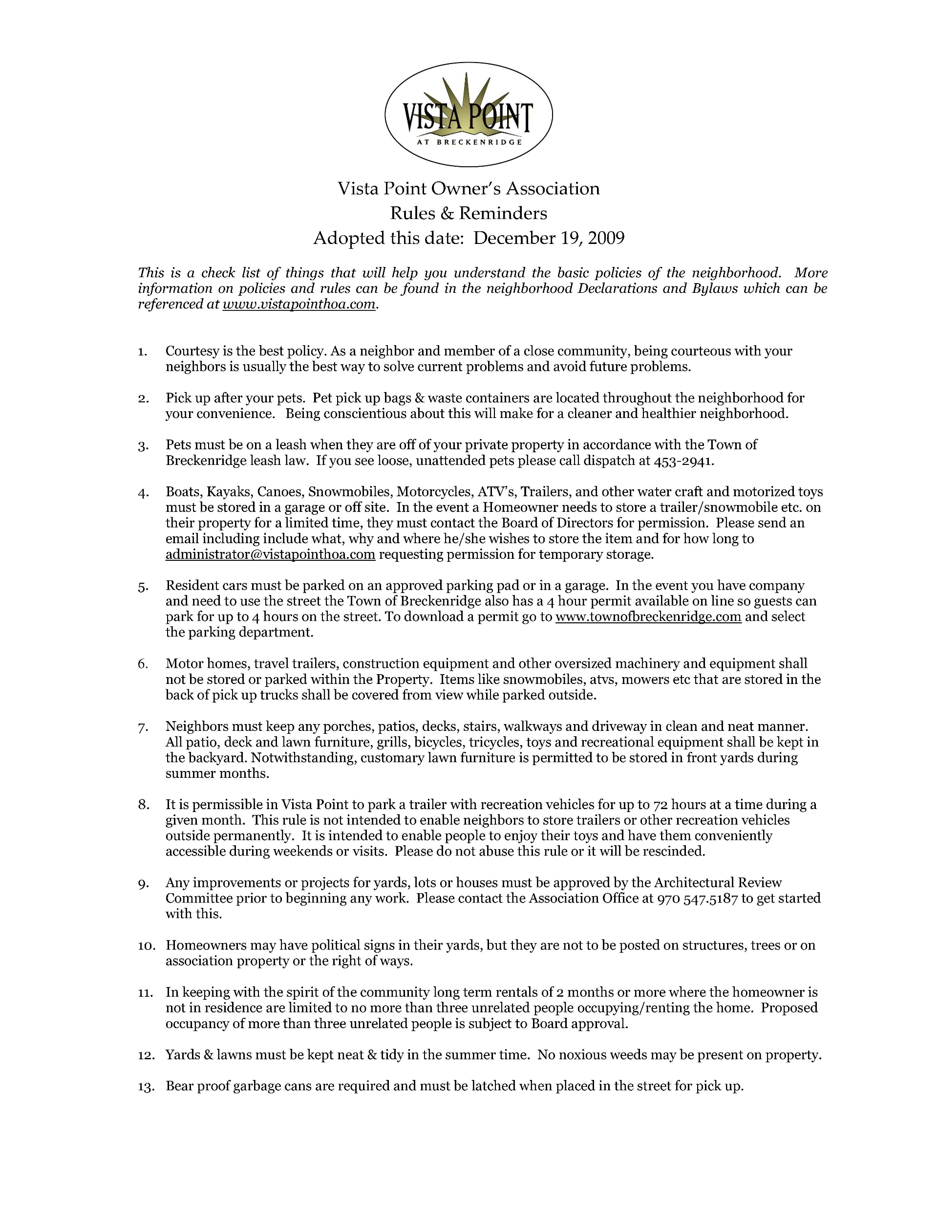

Slide 18
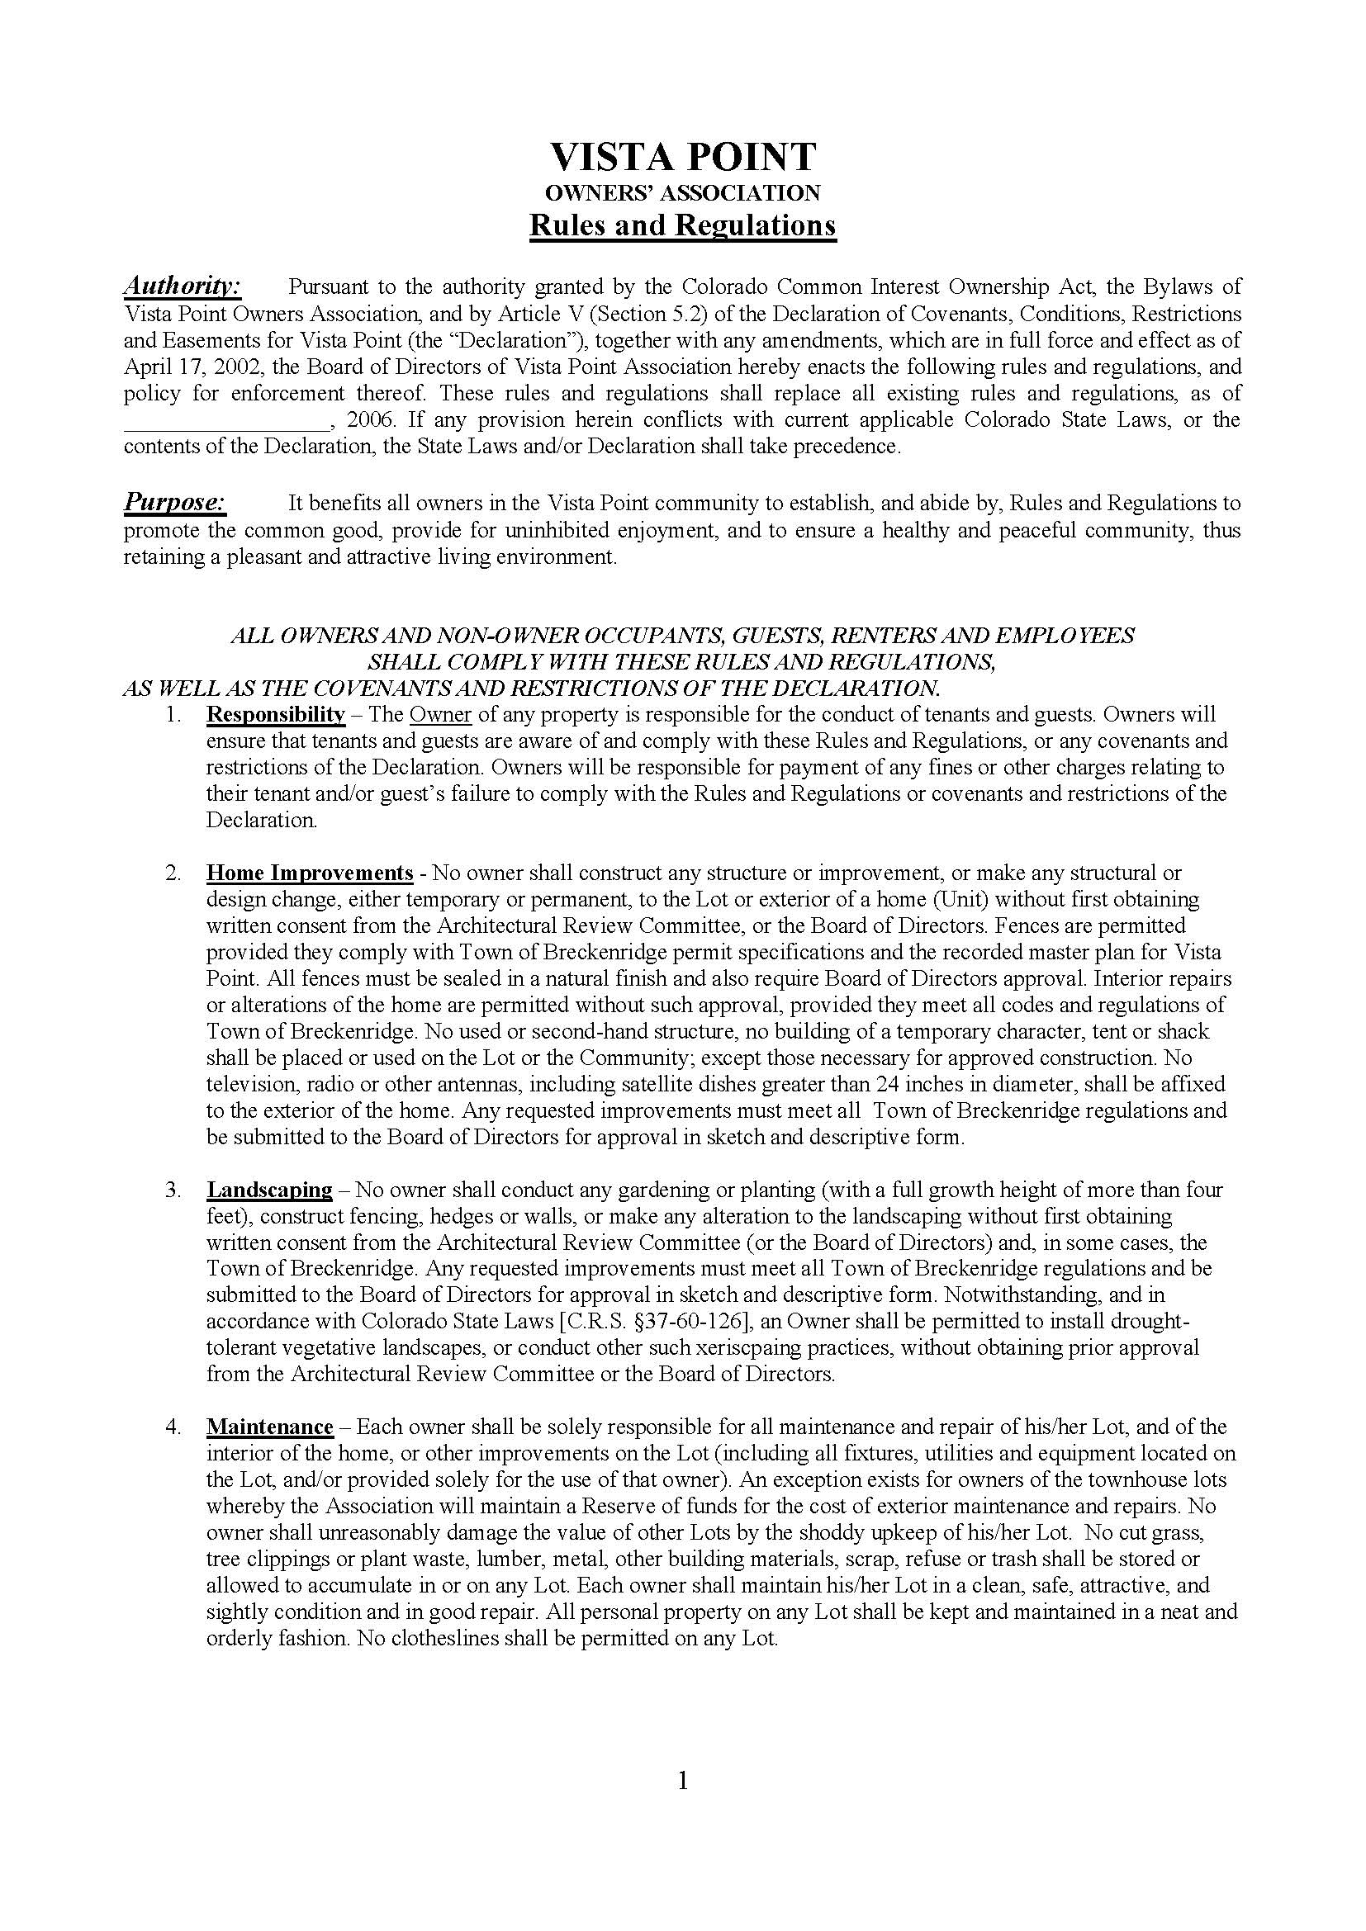

Slide 19
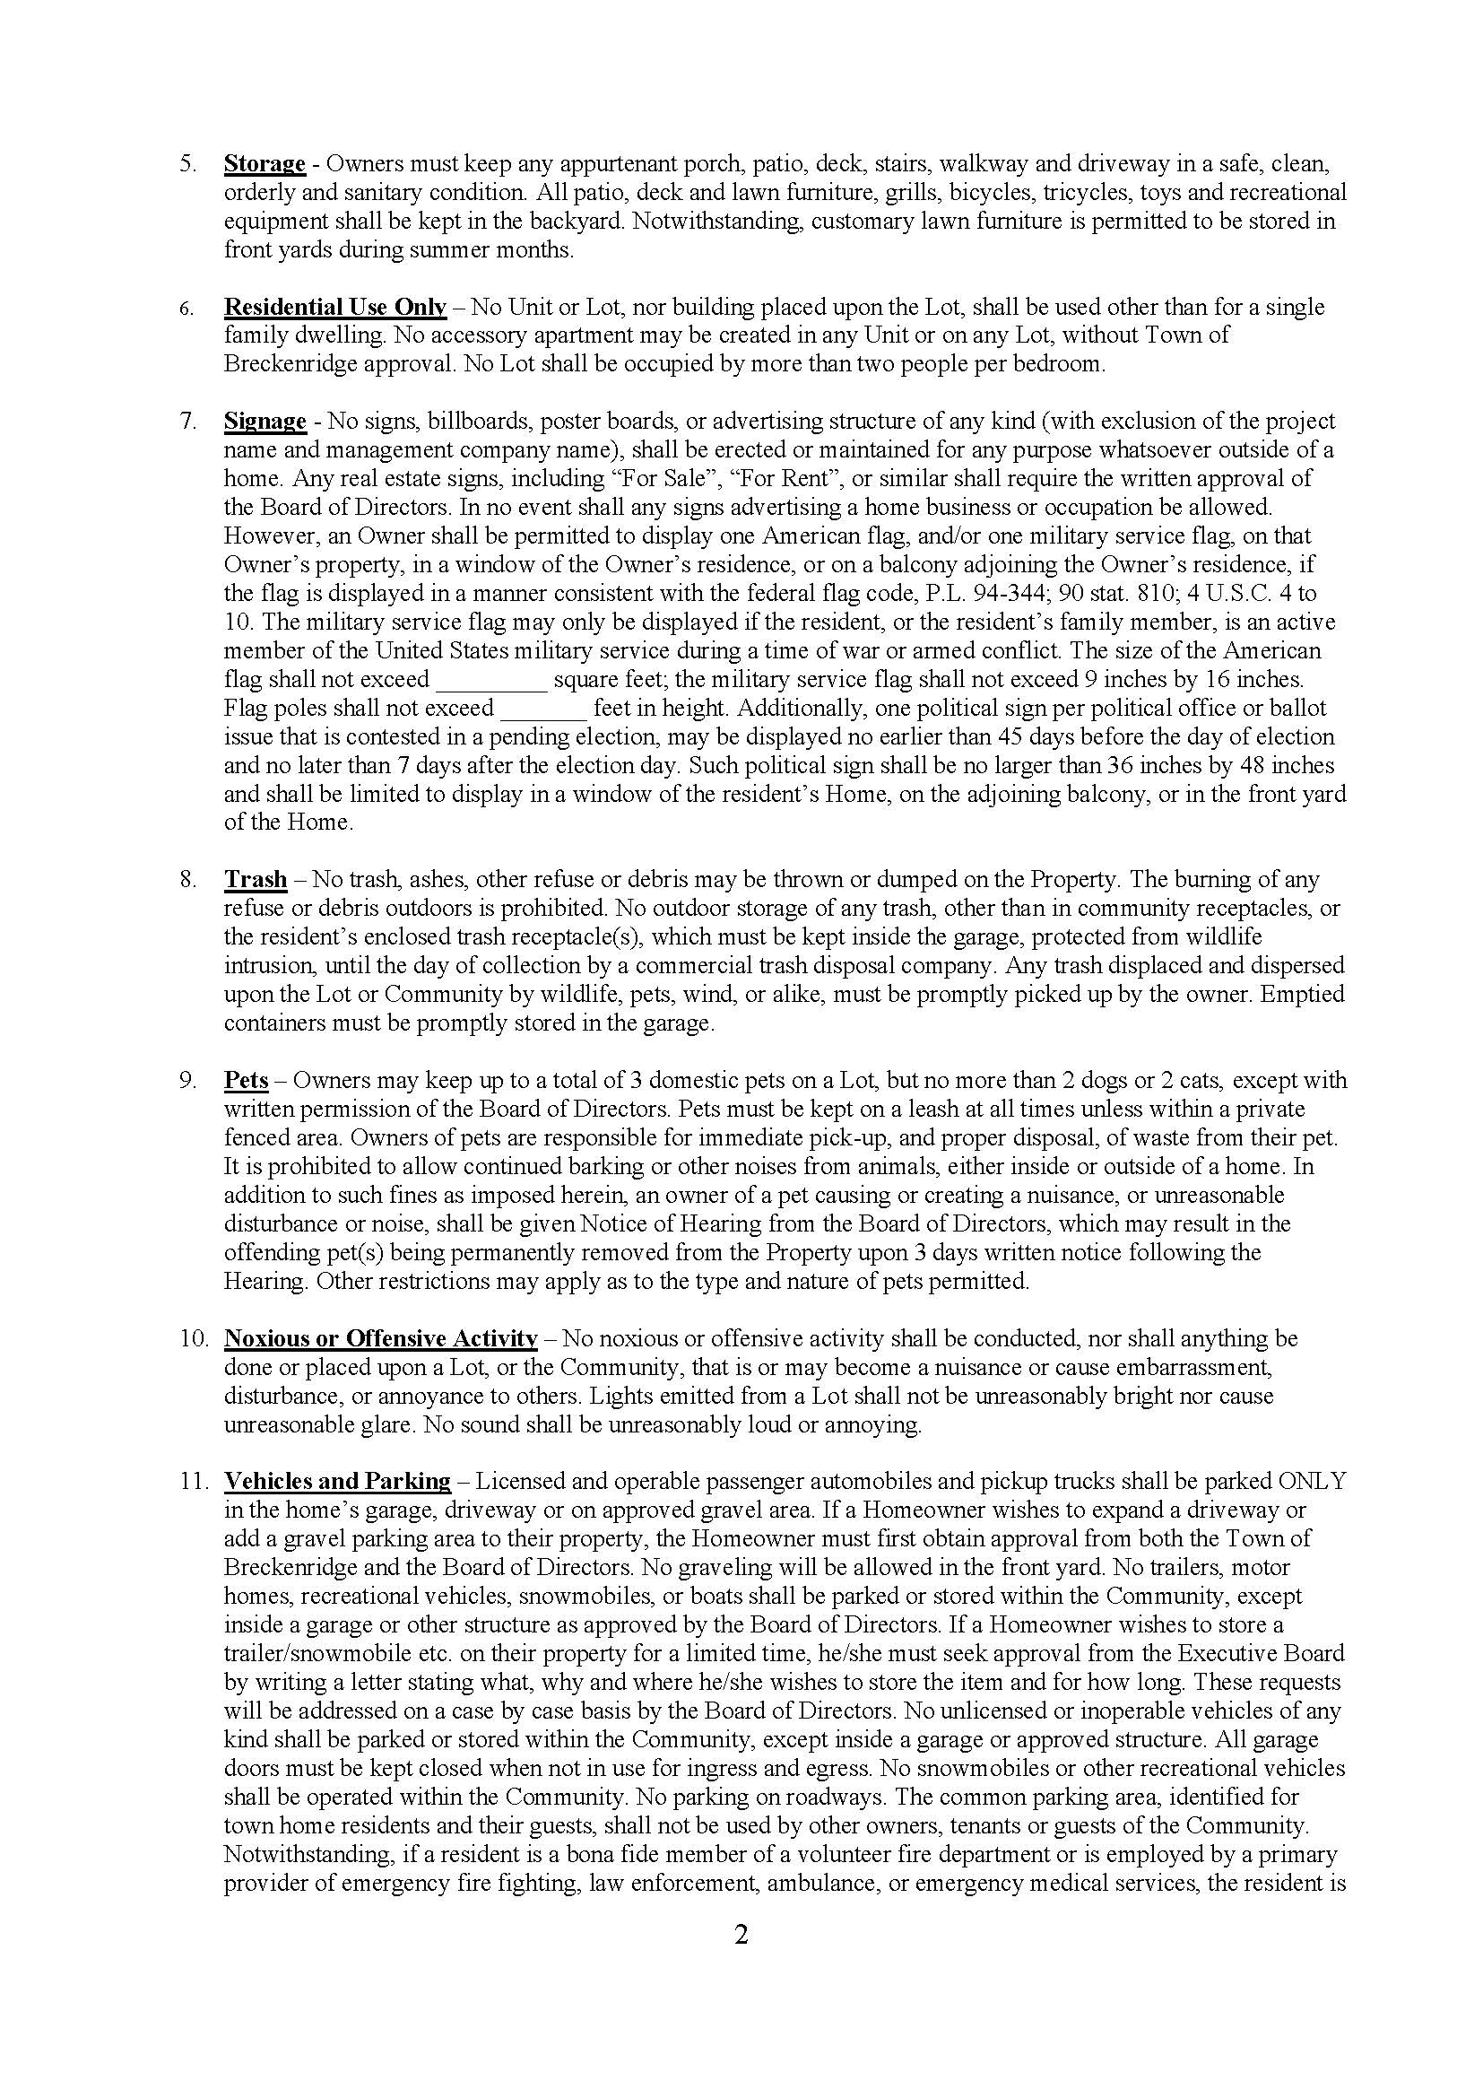

Slide 20
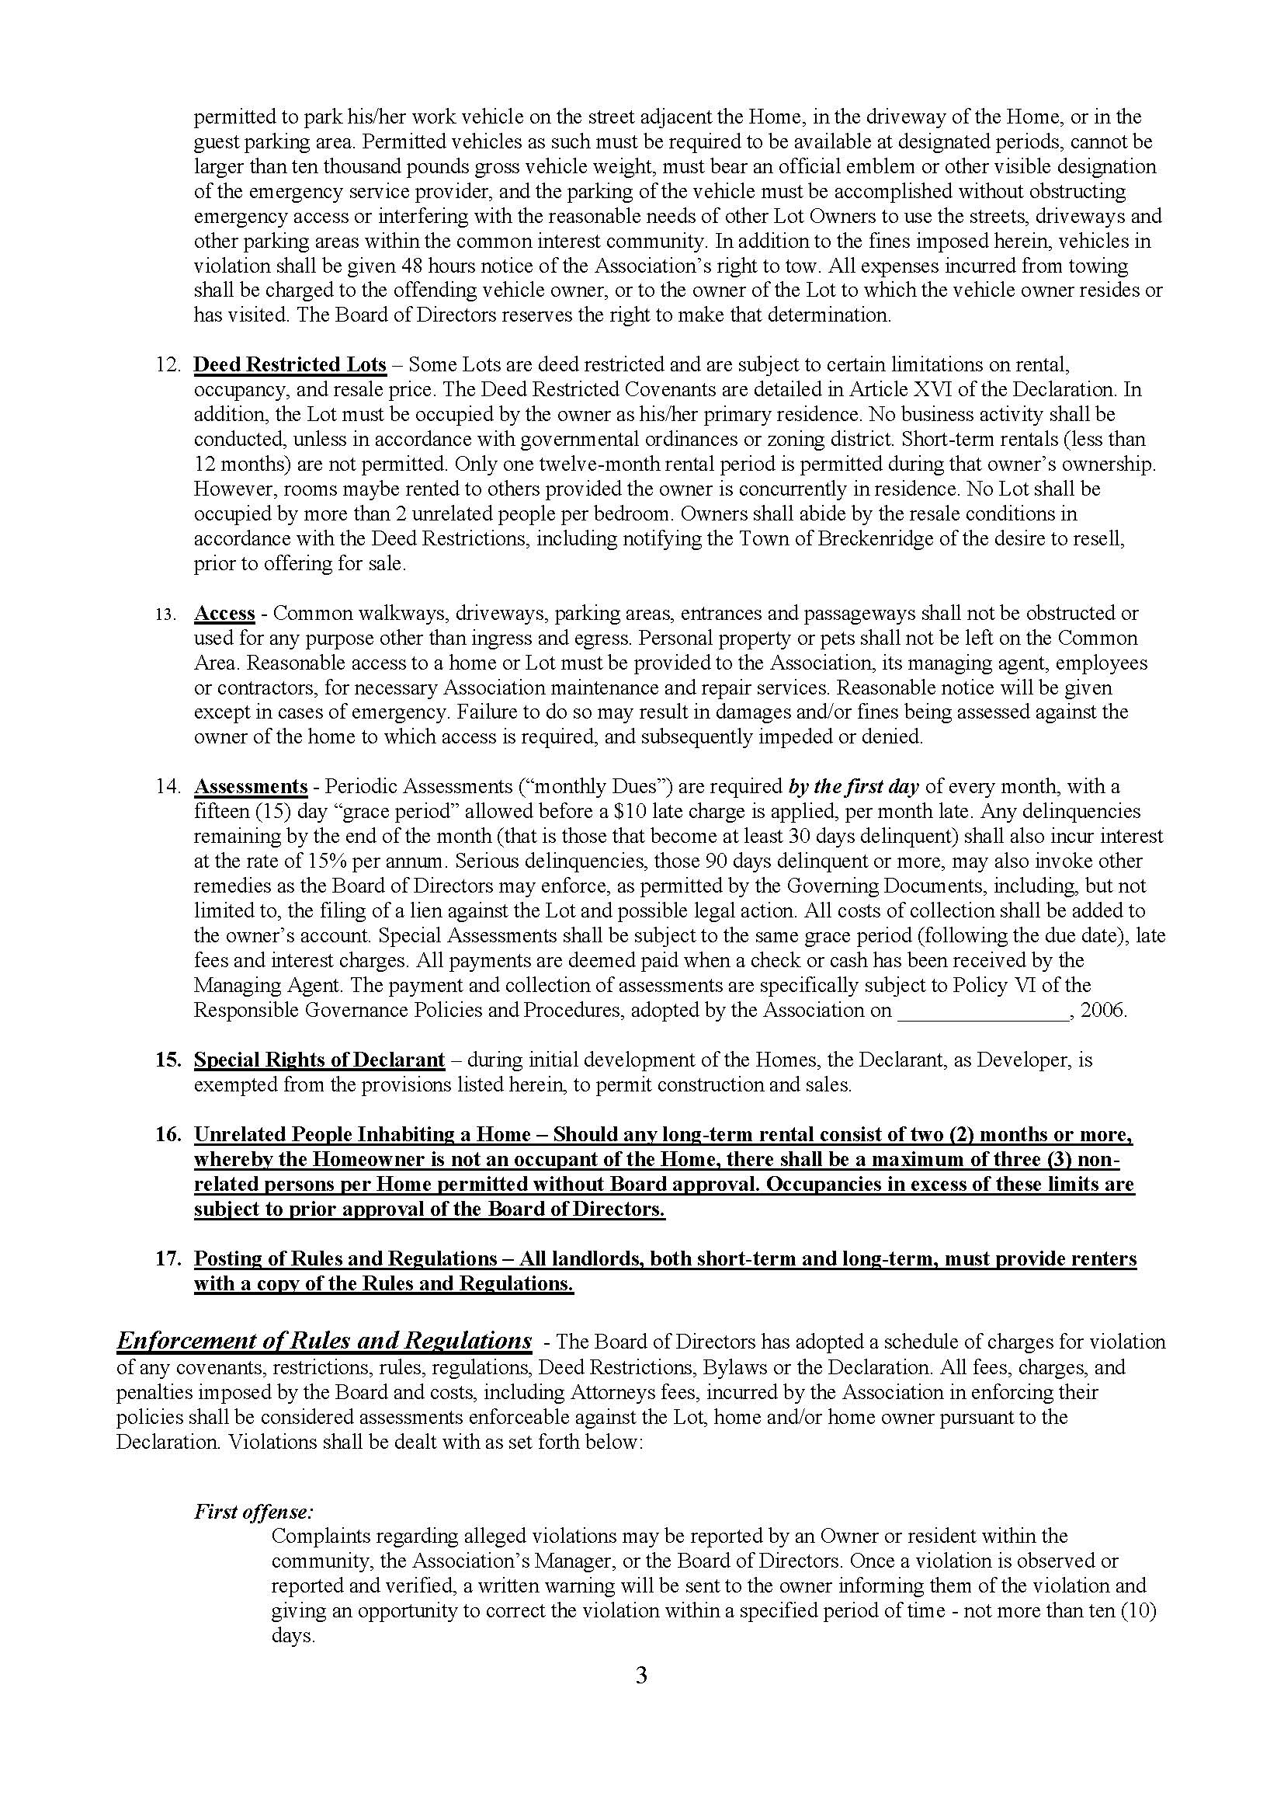

Slide 21
